Slide 1
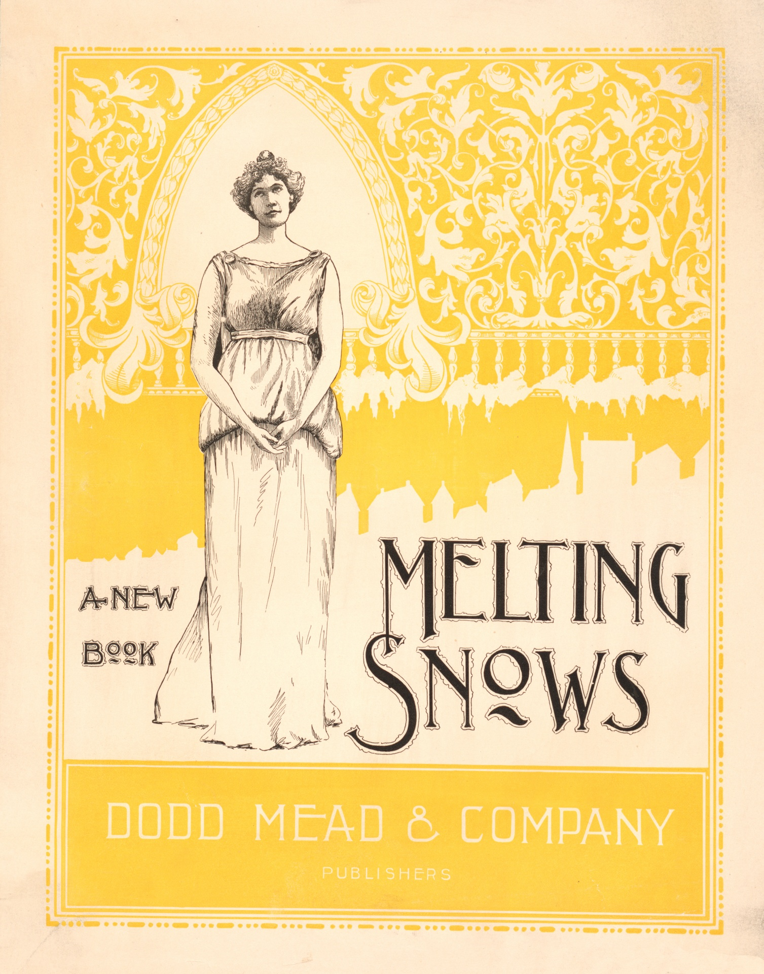

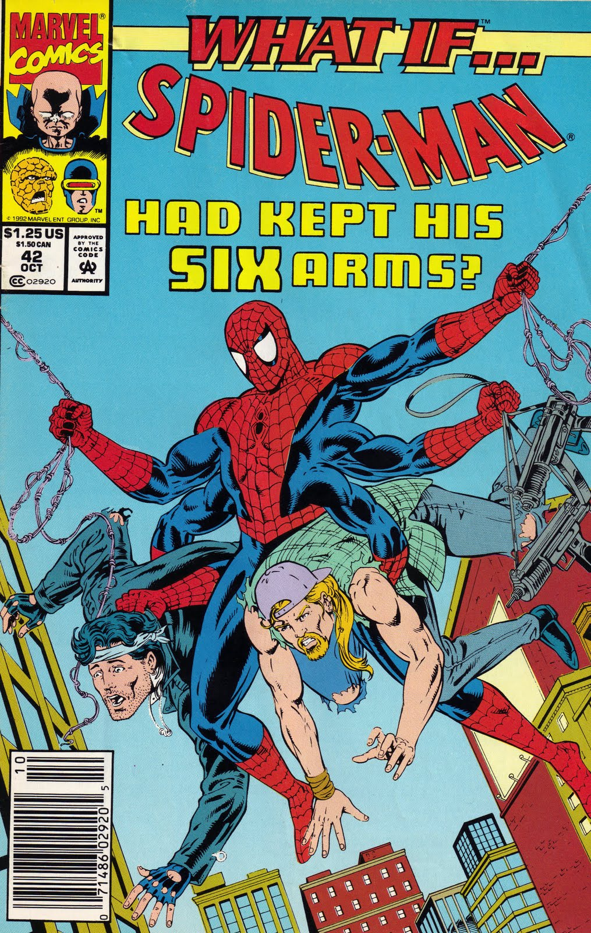

Judging A Book by Its Cover
1805092- Ishika Tarin
1805114- Afroza Parvin Disa

Slide 2
Base paper
Title: Judging A Book By Its Cover
Published At: Computing Research Repository(CoRR)
Publication Date: 13 Oct 2017
Citation: 29
Link: https://arxiv.org/pdf/1610.09204v3.pdf
Ranked #1 on Genre Classification on Book Cover dataset

Slide 3
code
dataset
Two different group has worked on this paper:
https://github.com/akshaybhatia10/Book-Genre-Classification
https://github.com/sidsudhakaran/BookCoverClassifier
Official book dataset that was made by the researchers just for this paper :
https://github.com/uchidalab/book-dataset
2. Imagenet
https://image-net.org/index.php

Slide 4

Base Paper Key Ideas:
The key ideas of the paper are:
1. Using a deep Convolutional Neural Network (CNN) to predict the genre of a book based on its cover.
2. Demonstrating that connections between book genres can be learned using only cover images.
3. Adapting AlexNet pre-trained on ImageNet for the task of genre recognition.
4. Revealing the relationships automatically learned between genres and book covers.
5. Exploring the design principles that the CNN was able to automatically learn, including text qualities and font properties.

Slide 5
Network Architecture
AlexNet
5 Convolutional Layer
3 Fully Connected Layer
Trained with gradient decent with an initial learning rate of 0.01, after which, the learning rate was divided by 10 every 100,000 iterations. The reported results were taken after 450,000 iterations. Also, a weight decay of 0.0005 and momentum of 0.9 was implemented.
2. LeNet
3 Convolutional Layer
1 Max Pooling Layer
1 softmax output layer
Each layer used ReLU activations and a constant learning rate of 0.0001. Dropout with a keep probability of 0.5 was used after the fully connected layer. Finally, the network was trained for 30,000 iterations of using an Adam optimizer

Slide 6
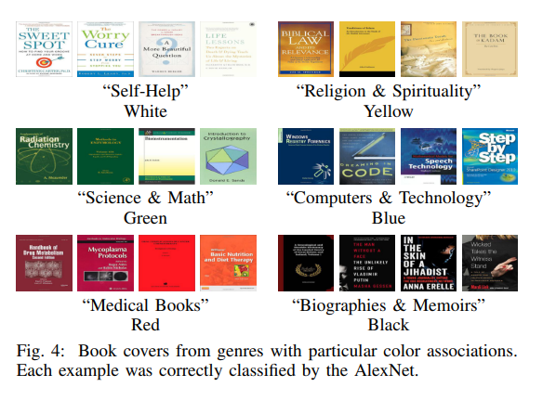
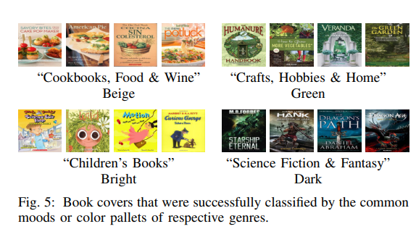
LEARNT BOOK COVER DESIGN PRINCIPLE
1.Based on Color
2. Based on Pallets

Slide 7
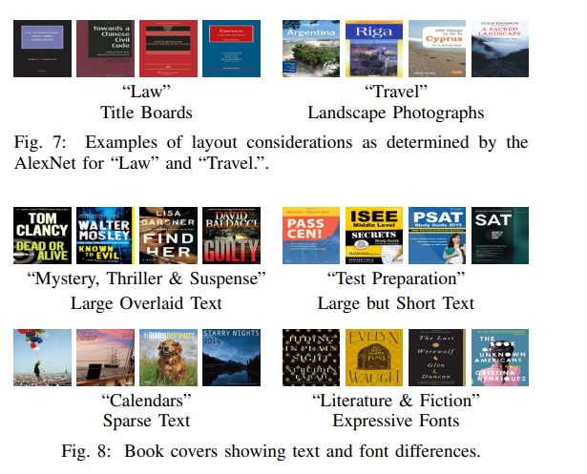
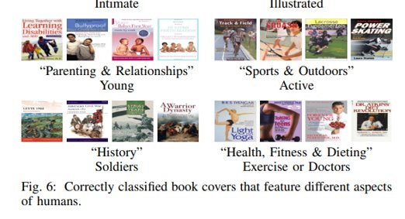
LEARNT BOOK COVER DESIGN PRINCIPLE
3. Based on text and layout
4. Based on Object

Slide 8
Our proposal
Dataset: We'll build a large dataset of Bengali books by web scrapping to test our model
2. Genre reduction: 30 classes of genres were used here. AlexNet got 24.7% accuracy and LeNet got 13.5% accuracy in the provided architecture. We will try to increase accuracy by reducing genre to more mainstream classes.
3. Multi label Classification: Here single label classification was used. Randomization was done when the book went to multiple class. Multi label classification can decrease misclassification.
4. Increasing the size of the network or tuning the hyperparameters may improve the performance.

Slide 9
THANK YOU

